Slide 1
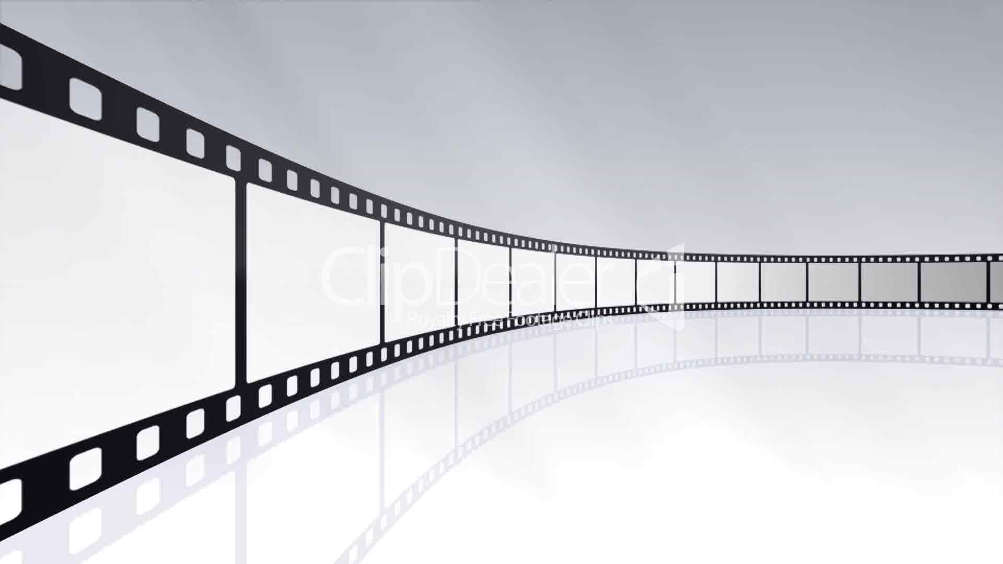

Movie mystery
The game everyone is playing

Slide 2
Elevator pitch
We have created a very simple user friendly quiz game that tests the users knowledge on their favourite films. With a large movie database we can access thousands of films.

Slide 3
Concept
Our project is a movie quiz that tests the users knowledge on how well they *really* know their favourite movies!
The underlaying benefit to using this app is to actually train your brain and help you ultimately learn more about your favourite movies. It is designed to be extremely user friendly so this includes a responsive mobile version.
Movie Mystery can be implemented into your day to day life with ease. Just pick up your device and enjoy the quiz!
Upon arrival, the user will find themselves greeted by a selection of popular movie posters. Once the user clicks on their chosen movie poster it will navigate them to the quiz. When answering the given questions, you will be rewarded at the end with a funny GIF!. When you are ready to test your knowledge on a different movie, there is a handy button on the quiz page that will navigate the user back to the entrance.
Description
As a group, we decided amongst us that we all really love movies, and wanted to develop an app that lets us test our knowledge.
We wanted to create an app that would be achievable with the given allocated time and current combined group skill level. This logic lead us to the development of MOVIE MYSTERY.
As a movie geek, I want a simple, fun trivia app that lets me test my knowledge about my favourite movies which in turn, will help train my brain into learning all the relevant movie facts.
motivation/reason for dev
User story

Slide 4
Process
OPEN MOVIE DB API
GIPHY API
JQUERY
MOMENT.JS
BULMA FRAMEWORK
Tech
For the majority of the development process, we all mobbed, taking it in turns to drive the app in set intervals.
Once the app was in the final stages, we split into smaller groups. One group worked on polishing the app and code, whilst the other focused on presentation.
Tasks & roles
Some of the challenges we came across included integrating BULMA framework into our app.
We also took much longer than expected pulling the relevant information from the MOVIE DB. In turn this put much more pressure on us towards the end to complete our MVP.
Dealing and understanding the AJAX scope was a large issue. This took some amount of time to resolve.
Mobbing in a group really helped us all to understand what each other was doing, their thought processes and solving problems. We got a lot of work done using this process and above all, it allowed us all to evenly contribute.
Challenges
Successes

Slide 5
Demo

Slide 6
future development
A score tally that is displayed at the end of the quiz
Add more questions to the app
Framework redesign
Add a search feature alongside displaying random movies to provide more user options
Introduce difficulty modes
Include a timer
Keep updating and making it more awesome!

Slide 7
Links
Github repo - https://github.com/vernerkeel/MovieMystery
Deployed site - https://vernerkeel.github.io/MovieMystery/index.html

Slide 8
Credits
MOVIE Mystery developed by..
Abdullah ahmed
Verner keel
James Davies
Fury foxes

